Slide 1
Summative Assessment 1
By Antonio III

Slide 2
Chapters
Chapter 1 - Python Refresher
Chapter 2 - Graphical User Interface
Chapter 3 - Graphical User Interface part 2
Chapter 4 - File handling and regular expressions
Chapter 5 - Object Oriented Programming
Chapter 6 - Python Standard Library

Slide 3
Chapter 1
Ex01 Ex08 Bonus Ex02 Further Ex05
Ex02 Ex09 Bonus Ex03
Ex03 Ex10 Further Ex01
Ex04 Ex11 Further Ex02
Ex05 Ex12 Further Ex03
Ex06 Ex13 Further Ex04
Ex07 Bonus Ex01

Slide 4
Chapter 2
Ex01 Ex05
Ex02-1 Bonus Ex01
Ex02-2 Bonus Ex02
Ex03 Further Ex01
Ex04 Further Ex02

Slide 5
Chapter 3
Ex01
Ex02
Ex03
Ex04

Slide 6
Chapter 4
Ex01
Ex02
Ex03
Ex04
Ex05

Slide 7
Chapter 5
Ex01
Ex02
Ex03
Ex04
Ex05
Ex06

Slide 8
Chapter 6
Ex01
Ex02
Ex03
Ex04
Ex05

Slide 9
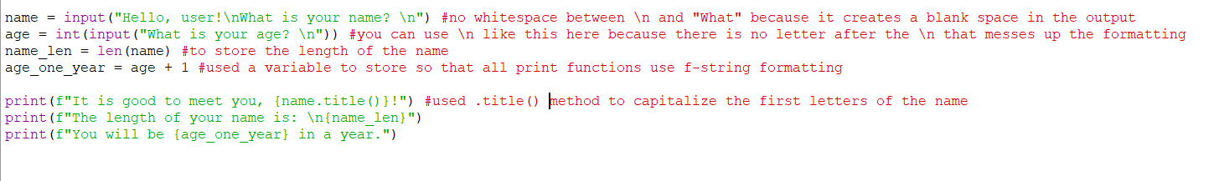
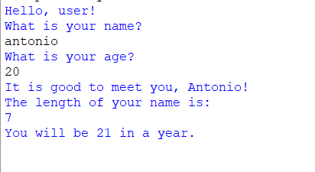
Ch1-ex01
back

Slide 10
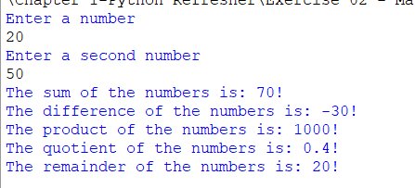
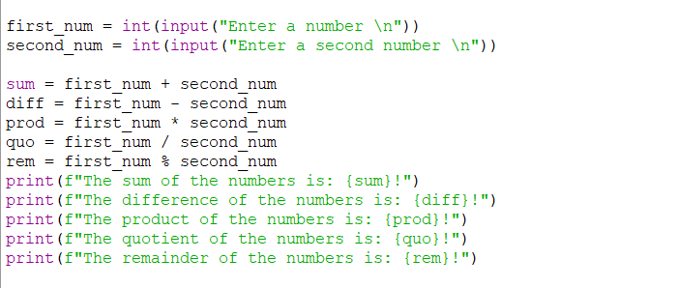
Ch1-ex02
back

Slide 11
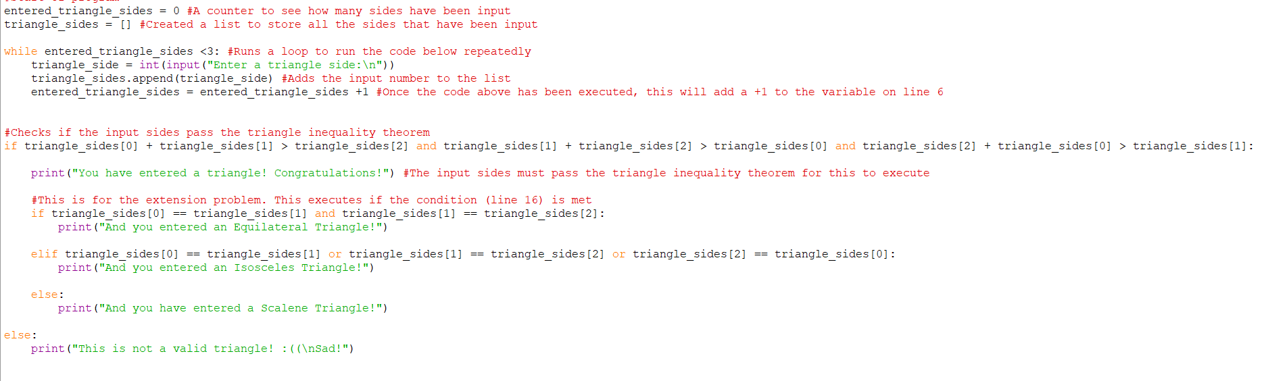
Ch1-ex03 code
back

Slide 12
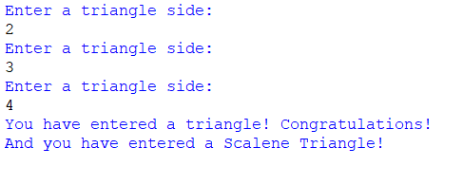
Ch1-ex03 output
back

Slide 13
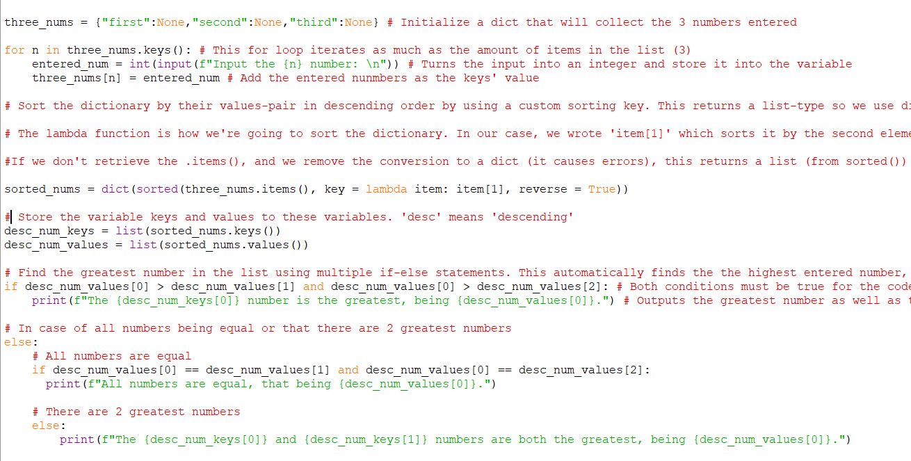
Ch1-ex04 code
back

Slide 14
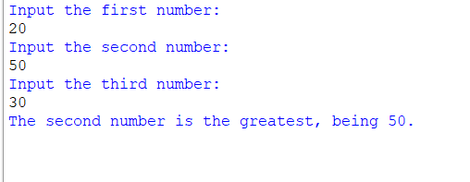
Ch1-ex-04 output
back

Slide 15
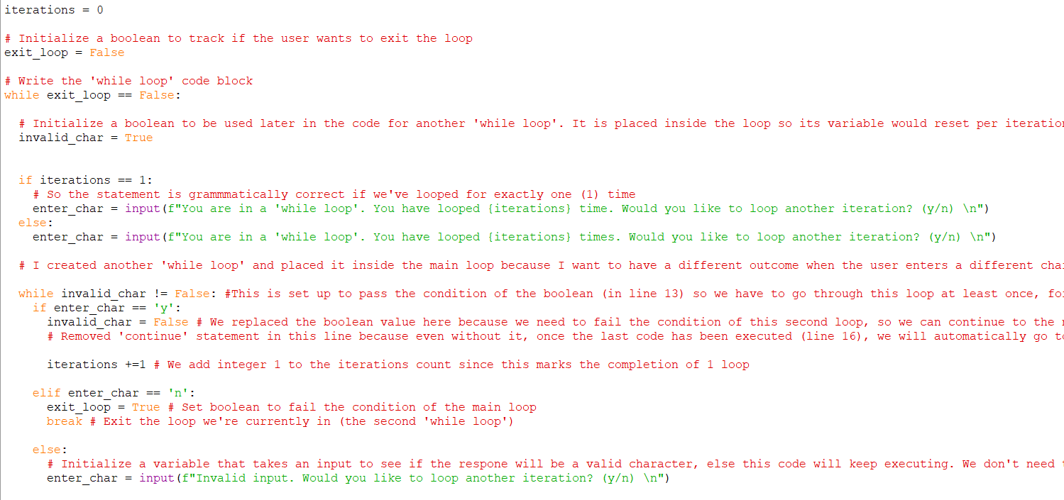
Ch1-ex05 code
back

Slide 16
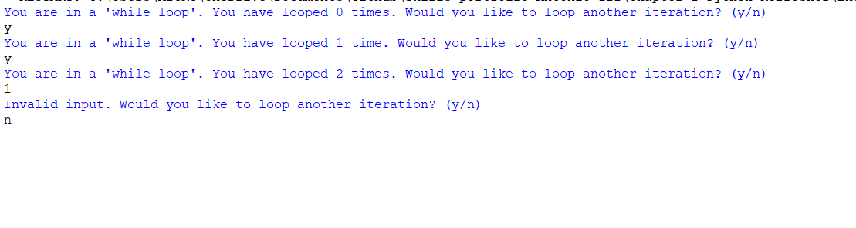
Ch1-ex05 output
back

Slide 17
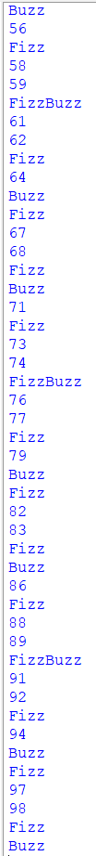
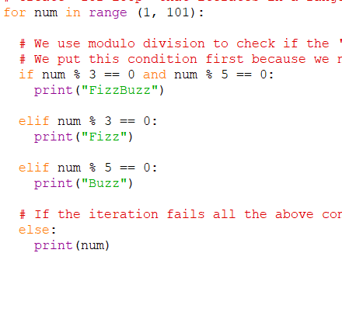
Ch1-ex06
back

Slide 18
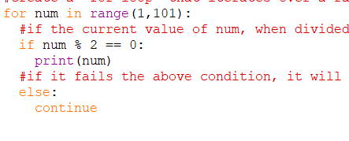
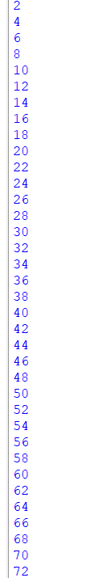
Ch1-ex07
back

Slide 19
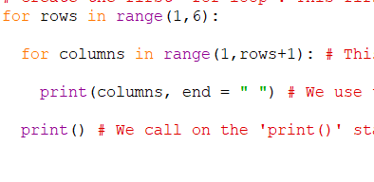
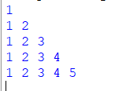
Ch1-ex08
back

Slide 20
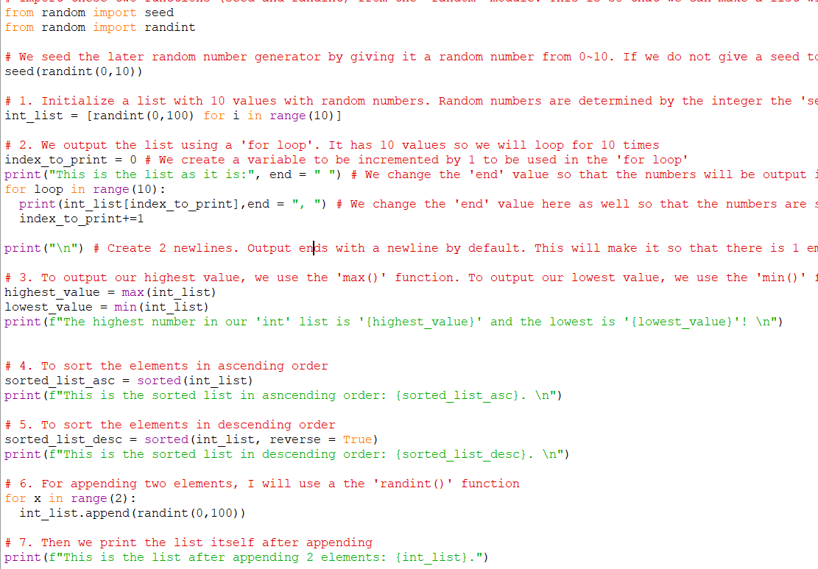
Ch1-ex09 code
back

Slide 21
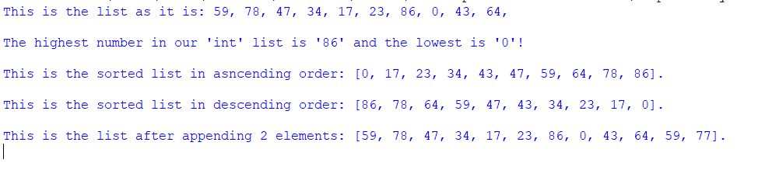
Ch1-ex09 output
back

Slide 22
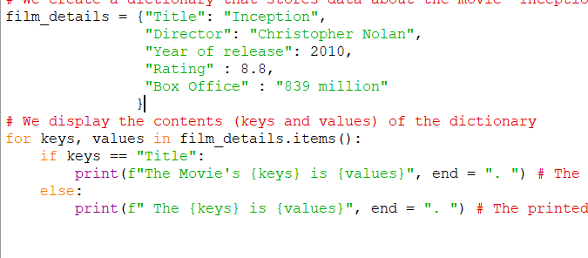
Ch1-ex10
back

Slide 23
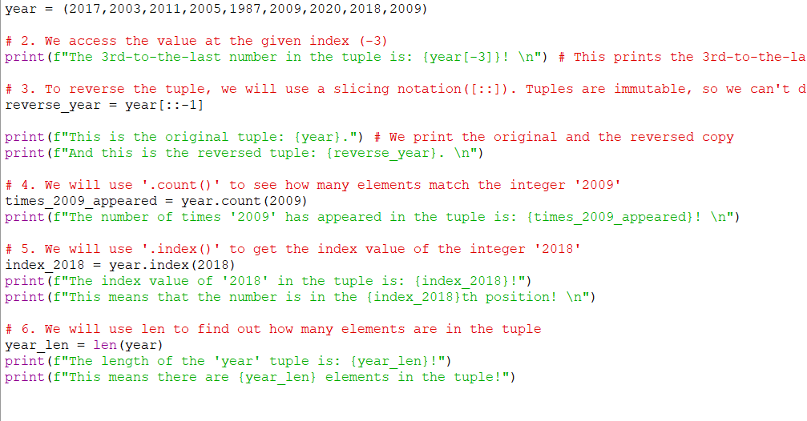
Ch1-ex11 code
back

Slide 24
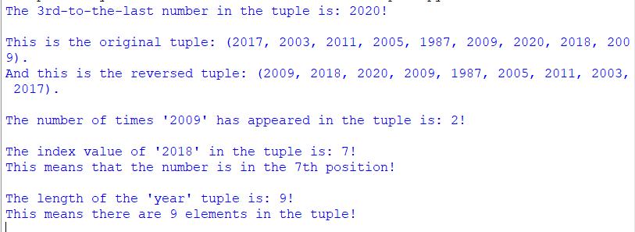
Ch1-ex11 output
back

Slide 25
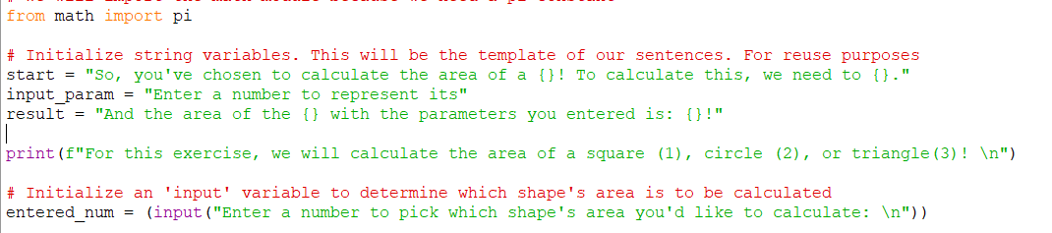
Ch1-ex12 code 1
back

Slide 26
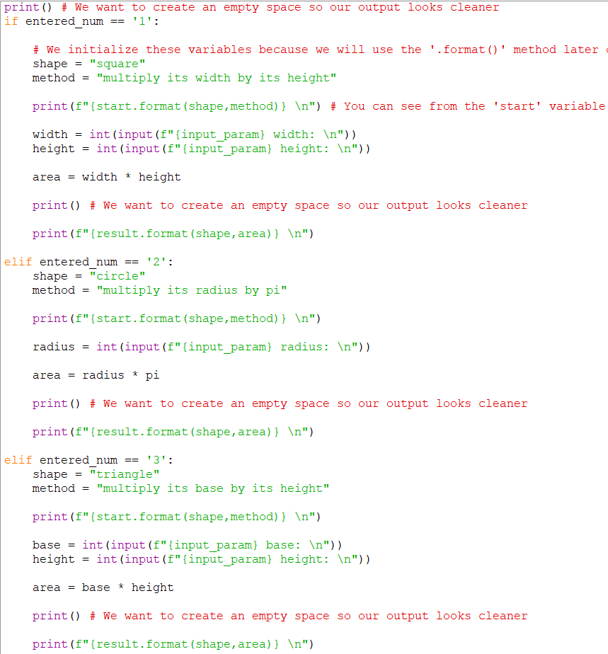
Ch1-ex12 code 2
back

Slide 27
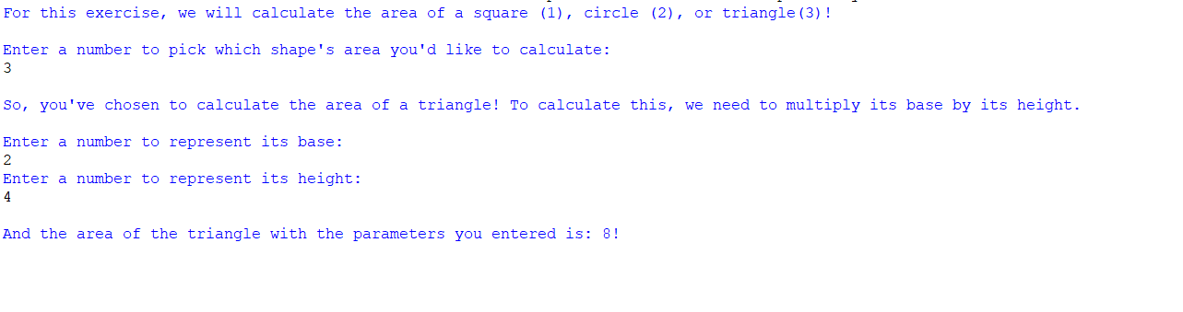
Ch1-ex12 output
back

Slide 28
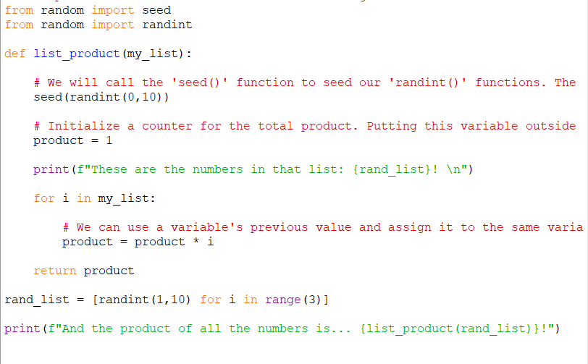
Ch1-ex13 code
back

Slide 29
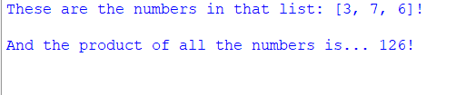
Ch1-ex13 output
back

Slide 30
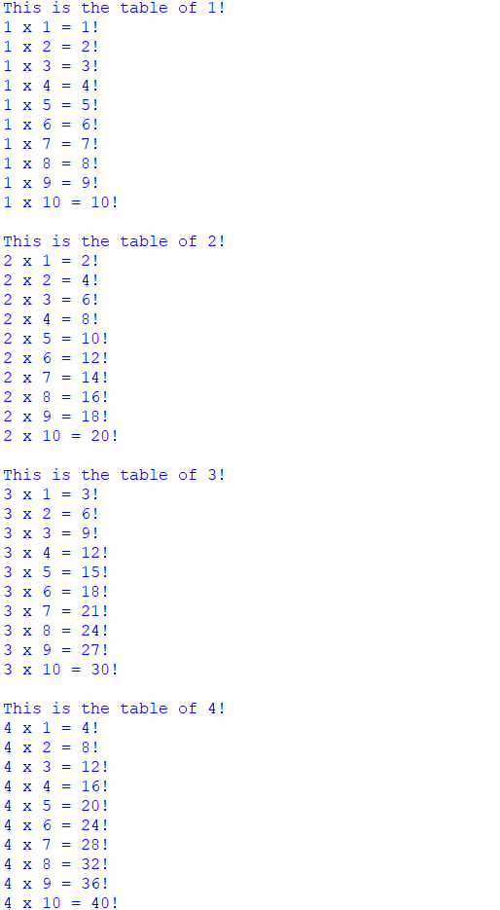
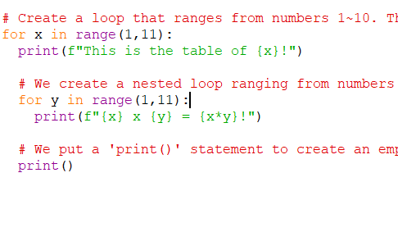
Ch1-bonus-ex01
back

Slide 31
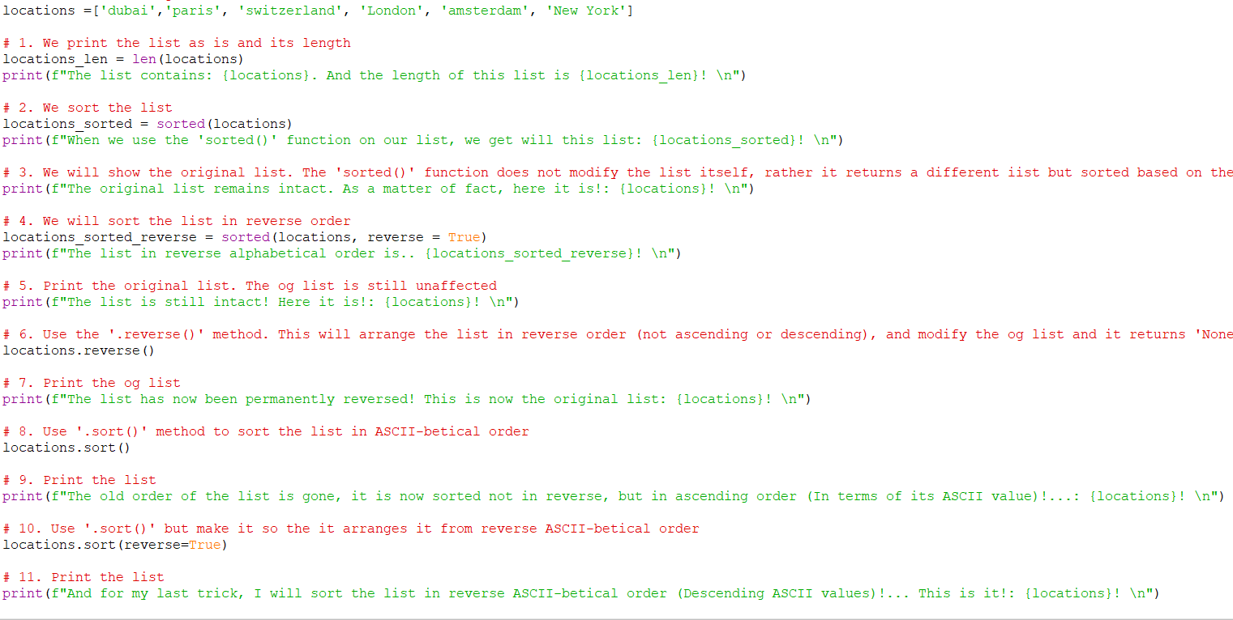
Ch1-bonus-ex02 code
back

Slide 32
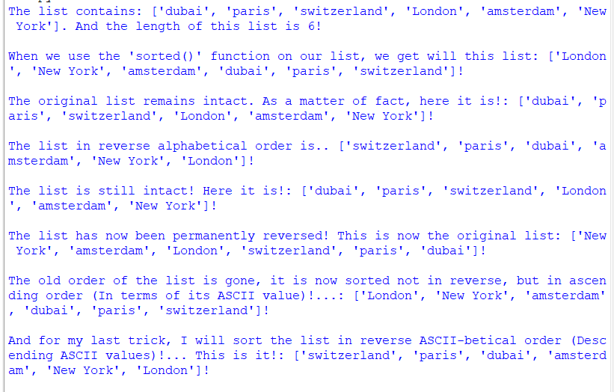
Ch1-bonus-ex02 output
back

Slide 33
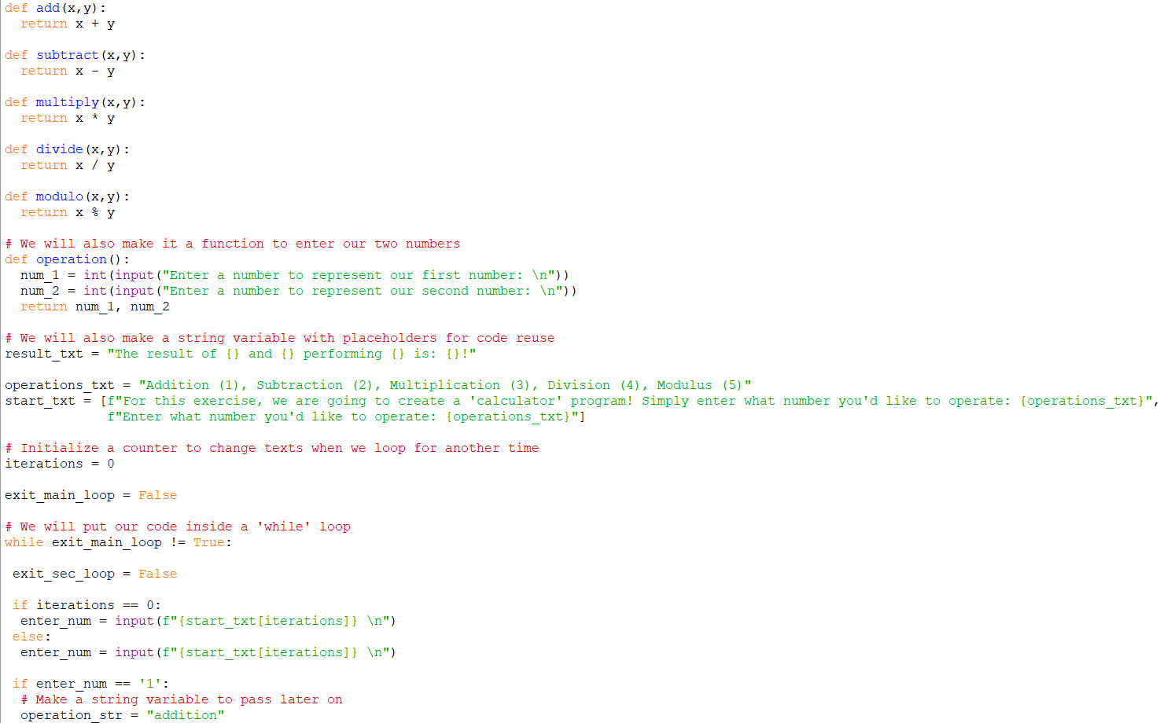
Ch1-bonus-ex03 code 1
back

Slide 34
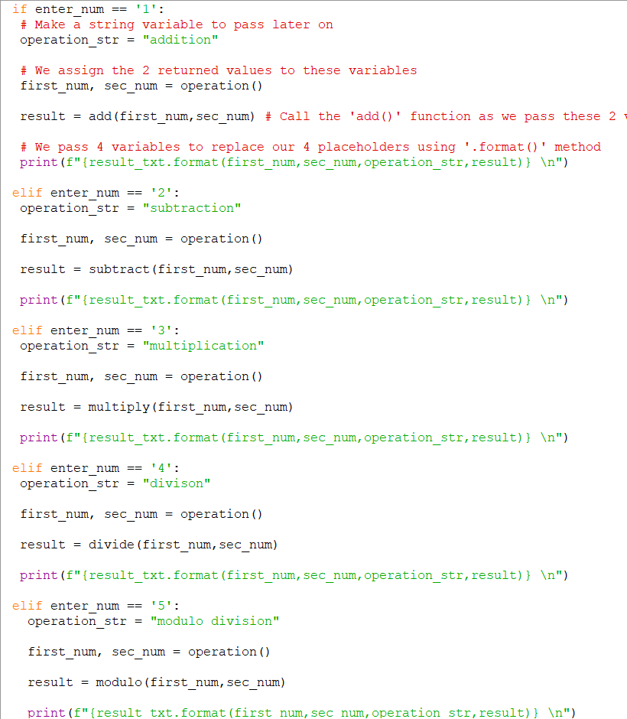
Ch1-bonus-ex03 code 2
back

Slide 35
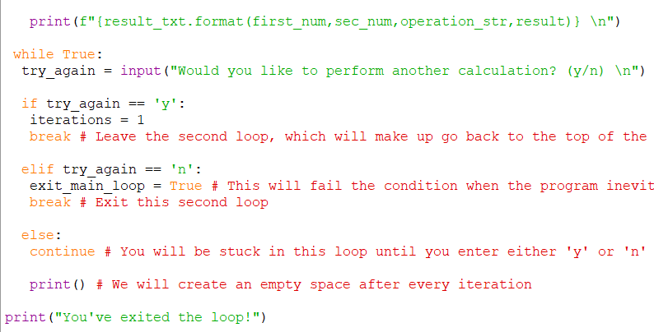
Ch1-bonus-ex03 code 3
back

Slide 36
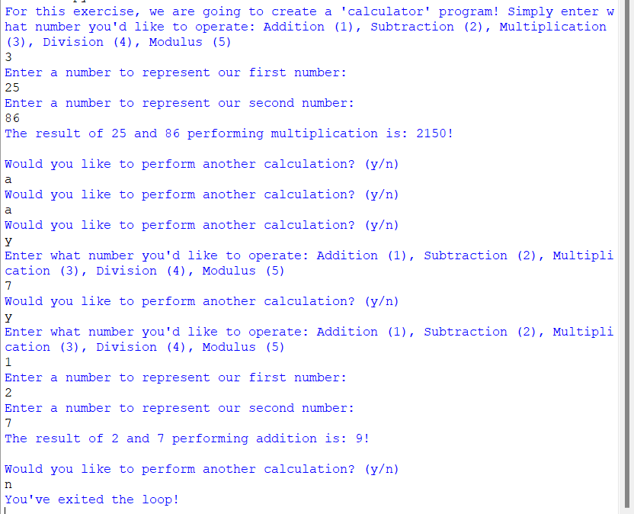
Ch1-bonus-ex03 output
back

Slide 37
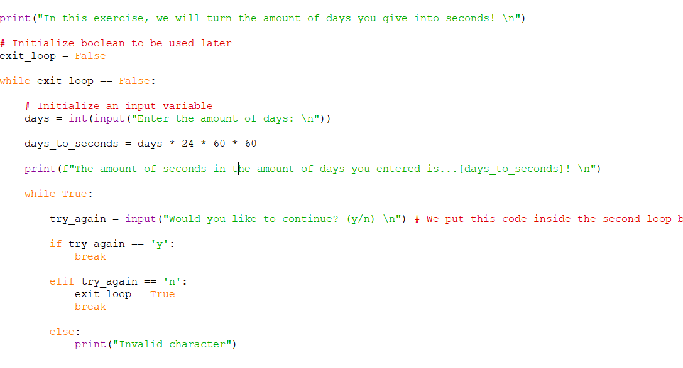
Ch1-further-ex01 code
back

Slide 38
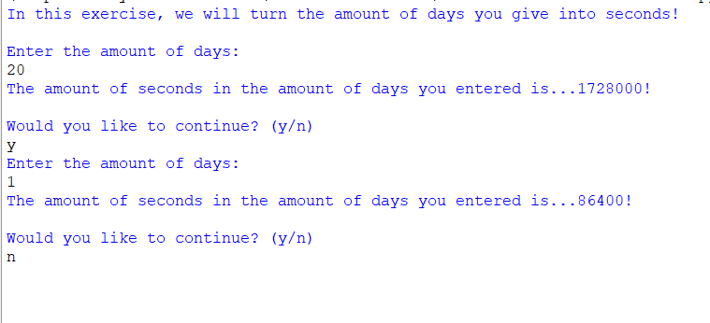
Ch1-further-ex01 output
back

Slide 39
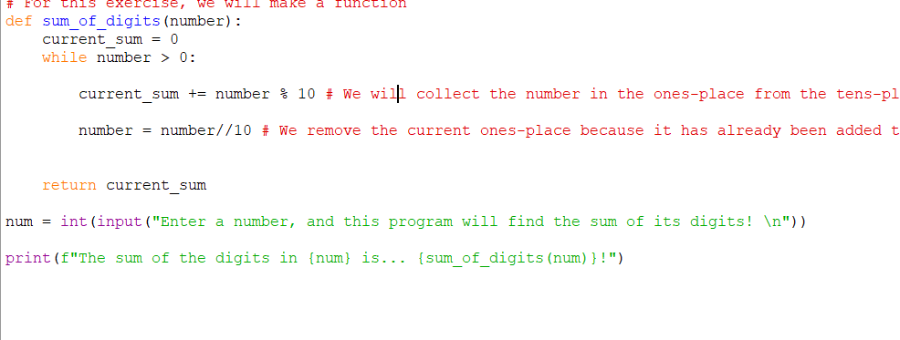
Ch1-further-ex02 code
back

Slide 40
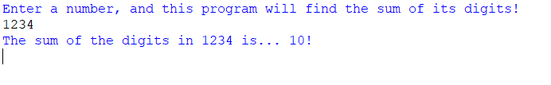
Ch1-further-ex02 output
back

Slide 41
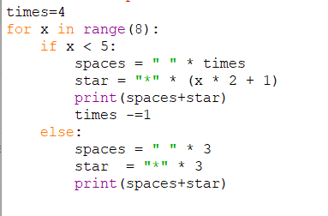
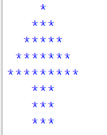
Ch1-further-ex03
back

Slide 42
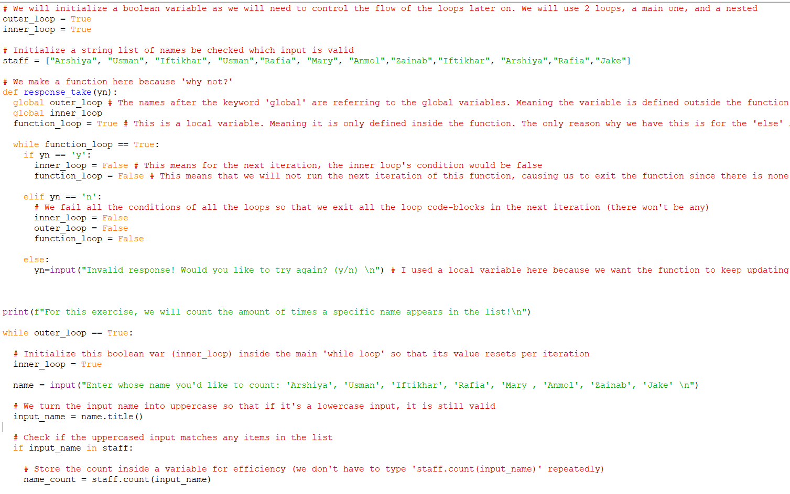
Ch1-further-ex04 code 1
back

Slide 43
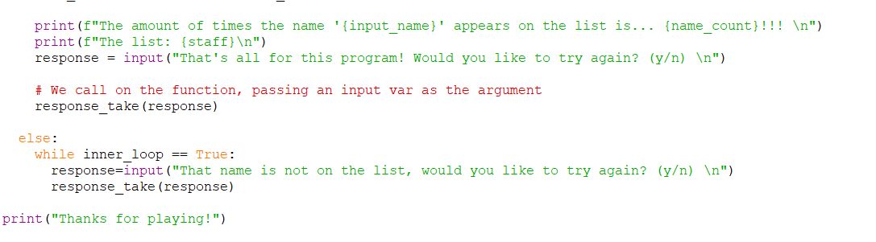
Ch1-further-ex04 code 2
back

Slide 44
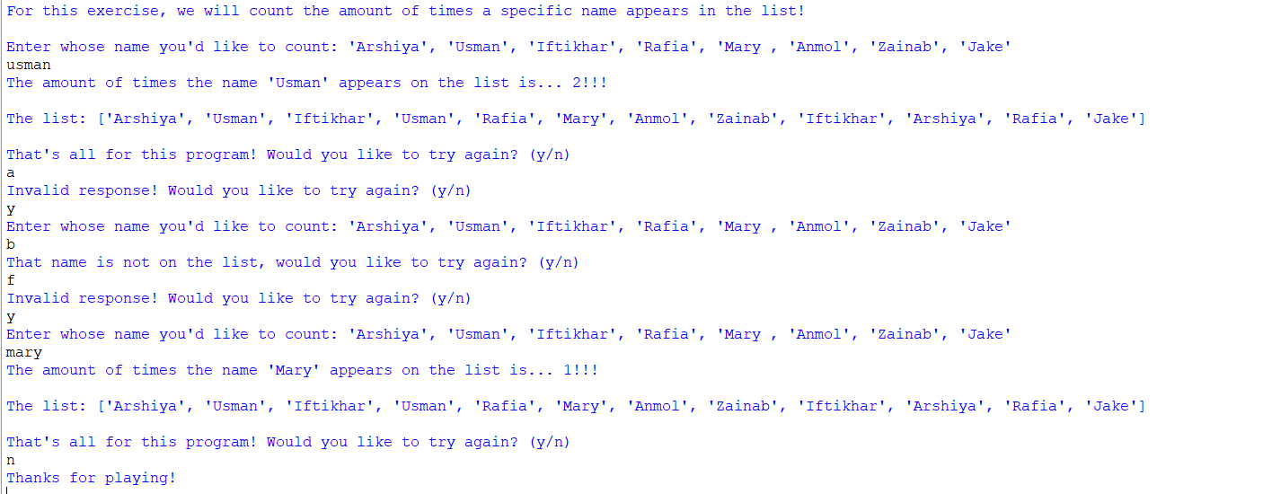
Ch1-further-ex04 output
back

Slide 45
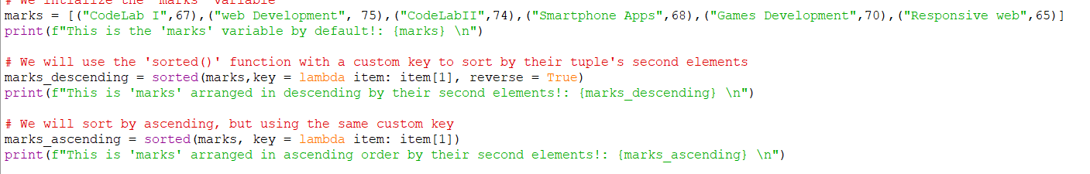
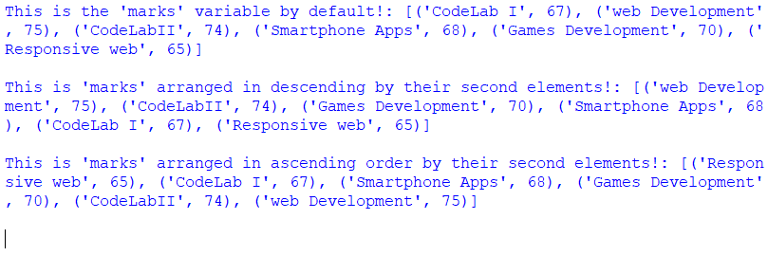
Ch1-further-ex05
back

Slide 46
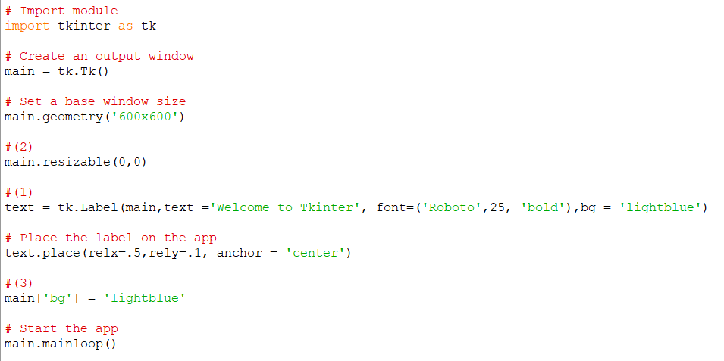
Ch2-ex01 code
back

Slide 47
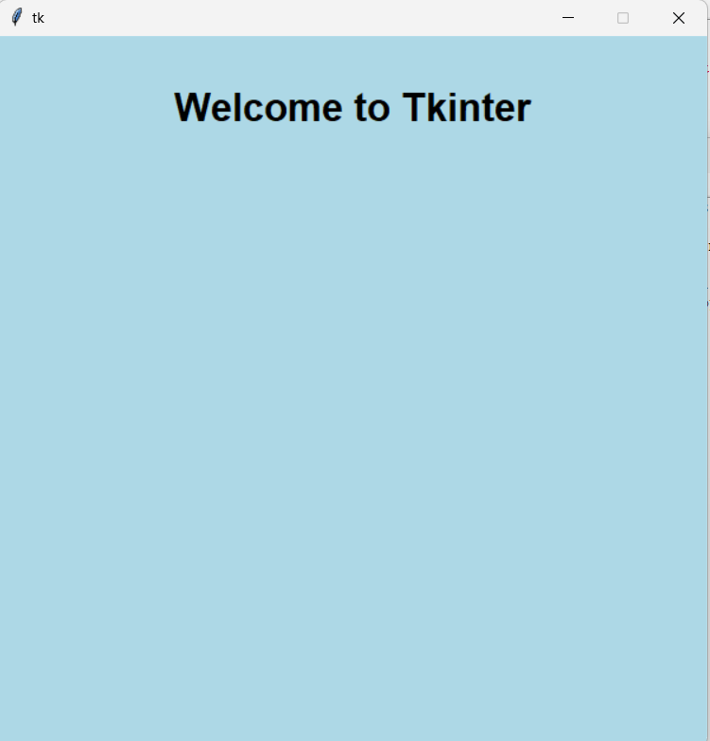
Ch2-ex01 output
back

Slide 48
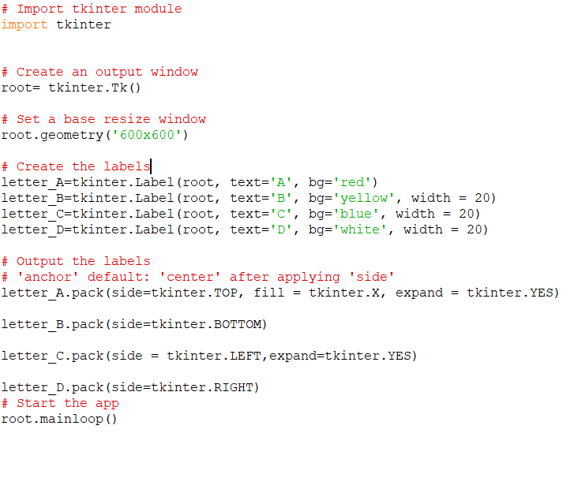
Ch2-ex02-1
back

Slide 49
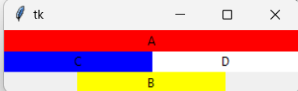
Ch2-ex02-1 output 1
back

Slide 50
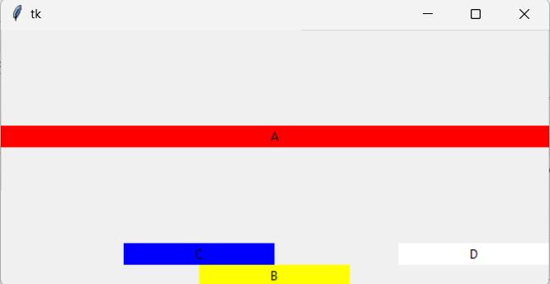
Ch2-ex02-1 output 2
back

Slide 51

Ch2-ex02-2 code 1
back

Slide 52

Ch2-ex02-2 code 2
back

Slide 53

Ch2-ex02-2 output
back

Slide 54

Ch2-ex03 code
back

Slide 55

Ch2-ex03 output
back

Slide 56

Ch2-ex04 code 1
back

Slide 57

Ch2-ex04 code 2
back

Slide 58

Ch2-ex04 code 3
back

Slide 59

Ch2-ex04 code 4
back

Slide 60

Ch2-ex04 code 5
back

Slide 61

Ch2-ex04 output
back

Slide 62

Ch2-ex05 code 1
back

Slide 63

Ch2-ex05 code 2
back

Slide 64

Ch2-ex05 output
back

Slide 65

Ch2-bonus-ex01 code 1
back

Slide 66

Ch2-bonus-ex01 code 2
back

Slide 67

Ch2-bonus-ex01 code 3
back

Slide 68

Ch2-bonus-ex01 output 1
back

Slide 69

Ch2-bonus-ex01 output 2
back

Slide 70

Ch2-bonus-ex02 code 1
back

Slide 71

Ch2-bonus-ex02 code 2
back

Slide 72

Ch2-bonus-ex02 output
back

Slide 73

Ch2-further-ex01 code
back

Slide 74

Ch2-further-ex01 output
back

Slide 75

Ch2-further-ex02 code 1
back

Slide 76

Ch2-further-ex02 code 2
back

Slide 77

Ch2-further-ex02 output
back

Slide 78

Ch3-ex01 code
back

Slide 79

Ch3-ex01 output 1
back

Slide 80

Ch3-ex01 output 2
back

Slide 81

Ch3-ex02 code 1
back

Slide 82

Ch3-ex02 code 2
back

Slide 83

Ch3-ex02 code 3
back

Slide 84

Ch3-ex02 code 4
back

Slide 85

Ch3-ex02 output
back

Slide 86

Ch3-ex03 code 1
back

Slide 87

Ch3-ex03 code 2
back

Slide 88

Ch3-ex03 code 3
back

Slide 89

Ch3-ex03 code 4
back

Slide 90

Ch3-ex03 code 5
back

Slide 91

Ch3-ex03 output 1
back

Slide 92

Ch3-ex03 output 2
back

Slide 93

Ch3-ex03 output 3
back

Slide 94

Ch3-ex04 code 1
back

Slide 95

Ch3-ex04 code 2
back

Slide 96

Ch3-ex04 output
back

Slide 97

Ch4-ex01 code 1
back

Slide 98

Ch4-ex01 code 2
back

Slide 99

Ch4-ex01 output
back

Slide 100

Ch4-ex02 code 1
back

Slide 101

Ch4-ex02 code 2
back

Slide 102

Ch4-ex02 output
back

Slide 103


Ch4-ex03
back

Slide 104

Ch4-ex04 code 1
back

Slide 105

Ch4-ex04 code 2
back

Slide 106

Ch4-ex04 output
back

Slide 107

Ch4-ex05 code 1
back

Slide 108

Ch4-ex05 code 2
back

Slide 109

Ch4-ex05 code 3
back

Slide 110

Ch4-ex05 output 1
back

Slide 111

Ch4-ex05 output 2
back

Slide 112

Ch5-ex01 code 1
back

Slide 113

Ch5-ex01 code 2
back

Slide 114

Ch5-ex01 code 3
back

Slide 115

Ch5-ex01 output
back

Slide 116

Ch5-ex02 code 1
back

Slide 117

Ch5-ex02 code 2
back

Slide 118

Ch5-ex02 code 3
back

Slide 119

Ch5-ex02 output
back

Slide 120

Ch5-ex03 code 1
back

Slide 121

Ch5-ex03 code 2
back

Slide 122

Ch5-ex03 code 3
back

Slide 123

Ch5-ex03 code 4
back

Slide 124

Ch5-ex03 output 1
back

Slide 125

Ch5-ex03 output 2
back

Slide 126

Ch5-ex03 output 3
back

Slide 127

Ch5-ex04 code 1
back

Slide 128

Ch5-ex04 code 2
back

Slide 129

Ch5-ex04 code 3
back

Slide 130

Ch5-ex04 output
back

Slide 131

Ch5-ex05 code 1
back

Slide 132

Ch5-ex05 code 2
back

Slide 133

Ch5-ex05 output
back

Slide 134

Ch5-ex06 code 1
back

Slide 135

Ch5-ex06 code 2
back

Slide 136

Ch5-ex06 output 1
back

Slide 137

Ch5-ex06 output 2
back

Slide 138

Ch5-ex06 output 3
back

Slide 139

Ch5-ex06 output 4
back

Slide 140

Ch6-ex01 code 1
back

Slide 141

Ch6-ex01 output
back

Slide 142

Ch6-ex02 code
back

Slide 143

Ch6-ex02 output
back

Slide 144

Ch6-ex03 code
back

Slide 145

Ch6-ex03 output
back

Slide 146

Ch6-ex04 code
back

Slide 147

Ch6-ex04 output
back

Slide 148

Ch6-ex05 code
back

Slide 149

Ch6-ex05 output
back

